Slide 1
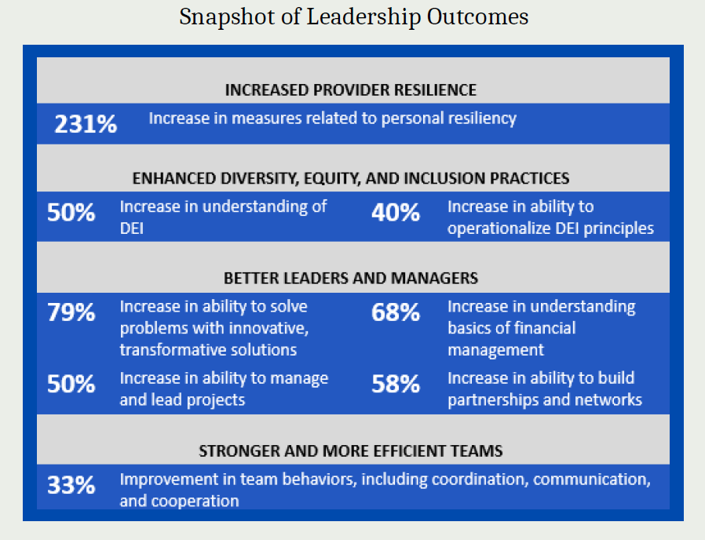
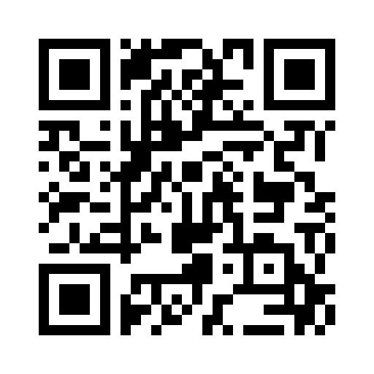
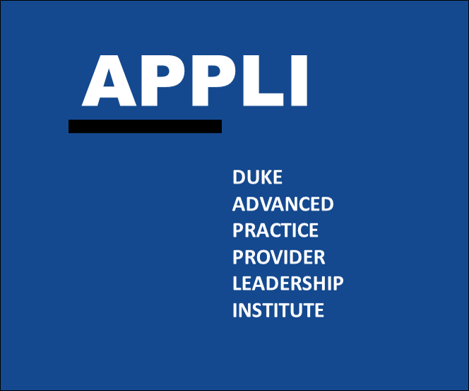
An IPP team-based training model is a viable structure for providing intensive healthcare leadership and management skills development. Interprofessional APN-led teams are able to plan and implement quality health improvement projects and gain valuable leadership skills.
Non-Cognitive Predictors of Student Success: A Predictive Validity Comparison Between Domestic and International Students
Preparing Advanced Practice Nurses and Their Interprofessional Teams for Excellence in Health Care Leadership
INTRODUCTION:
The Duke-Johnson & Johnson Nurse Leadership Program (now renamed Duke Advanced Practice Provider Leadership Institute, APPLI) launched in May 2013 with a mission to provide advanced practice nurses (APN) with transformational leadership development.
This program aimed for participants to implement transformational health improvement projects in their practice settings and communities, with a focus on addressing health disparities of vulnerable populations.
In 2020, the program transitioned from an individual training model to one that invited APN-led interprofessional healthcare TEAMS to participate in building high functioning teams and creating healthcare transformation.
The program enrolled 17 teams, comprised of 2-3 members each.
METHODS
Team-directed Transformational Projects
Synchronous Sessions:
Large Group Training Sessions
Zoom Breakout Rooms
Chat Functionality
Asynchronous Self-Directed Modules
Monthly Project Coaching Circles
Individual Executive Coaching
Evaluation
Pre-, Post-, and Retrospective Pre- Program Evaluations
Employer Survey
Project Outcomes Report
RESULTS
Teams’ projects, collectively, impacted over 22,000 patients and over 1,000 health care providers
20 - 25% overall increase in management and leadership competencies
11% increase in positive team functioning competencies
25% reduction in negative team functioning competencies
“The program taught me how to:
Listen 2. Ask questions 3. Engage the team 4. Prepare for meetings 5. Explain the problem and goals to the service line and administration to garner support 6. Believe and trust in the process, that it takes time!”
- Alumni Reflection
“[Participation] helped create a culture in the unit around value based care, which will carry forward from not just avoidance of routine daily lab ordering, but mindfulness in many areas of cost and efficiency”
- Employer Reflection
FUTURE CHANGES
Open enrollment opportunities to other Advanced Practice Providers (e.g. PA, PT, OT, LCSW, PharmD, etc.)
Expand IPP training content
Explore opportunities for specialty tracks (e.g. entrepreneurship, education, etc.)
“If you are looking for an environment where you are challenged to evaluate your leadership style, nurture your professional self and build a network of colleagues who have similar interests… this is the program for you”
- Alumni Reflection
CONTACT US
Camille Fulbright, BSPH, Project Coordinator, Dept. of Family Medicine and Community Health, DUSOM
Anh N. Tran, PhD, MPH, Vice Chief of Education, Dept. of Family Medicine and Community Health, DUSOM
Sarah Weaver, MPH, Research Project Manager, Dept. of Surgery, DUSOM
Take a picture to visit our program website
@DukeAPPLI
@DukeAPPLI
APPLI@duke.edu
Notes:
Notes:
In Powerpoint, click View > Guides
Keep text within gutter guides.
Author list: Don’t split names onto two lines (e.g., “Jimmy [break] Smith”). If that happens, use a new line, unless you need the space. Bold the first names of anybody who’s presenting in person.
Intro/methods/result: Do not drop below font size 28, but if you have extra space, jack up the font size until the space is full.
Do not use color in the sidebars except in graphs/figures. It’ll pull attention from the center and slow interpretation for passersby.

