Slide 1





Authors
Introduction
Akhila Belur, MD,
Assistant Professor of Medicine, Hospitalist-Duke Regional Hospital
Objectives
John Hoyle, MD,
Medical Instructor, Hospitalist-Duke Regional Hospital
Real World Training for the Next Generation:
A curriculum for resident education focused on system-based non-clinical patient care topics
Methods
Komal Safdar, MD,
Duke Internal Medicine Residency Chief Resident
Results
Pahresah Roomiany, MD, MS, FACP, Associate Medical Director of Education, Hospitalist-
Duke Regional Hospital
Discussion

Slide 2
Real World Training for the Next Generation:
A curriculum for resident education focused on system-based non-clinical patient care topics
Introduction
Objectives
Healthcare systems and individual physicians are evaluated on patient safety, quality, and performance metrics, all of which impact regulatory compliance and reimbursement.¹
The Accreditation Council for Graduate Medical Education (ACGME) designates systems-based practice (SBP) as one of the core competencies for physicians to develop during residency training.²
Teaching and assessing the specific skills required to meet this competency presents a significant challenge for both medical educators³ and learners.³
The primary goal is to help resident physicians understand how their clinical work and documentation impact patient care, quality metrics, and the broader healthcare system.
Assess learners’ knowledge and current workflow regarding system-based topics.
Develop a “Real World Curriculum” to educate resident physicians on key system-based non-clinical topics including clinical documentation improvement (CDI), discharge planning, Diagnosis-Related Groups (DRG), Relative Weight (RW), Case Mix Index (CMI), observation vs. inpatient admission status, and quality metrics.

Slide 3
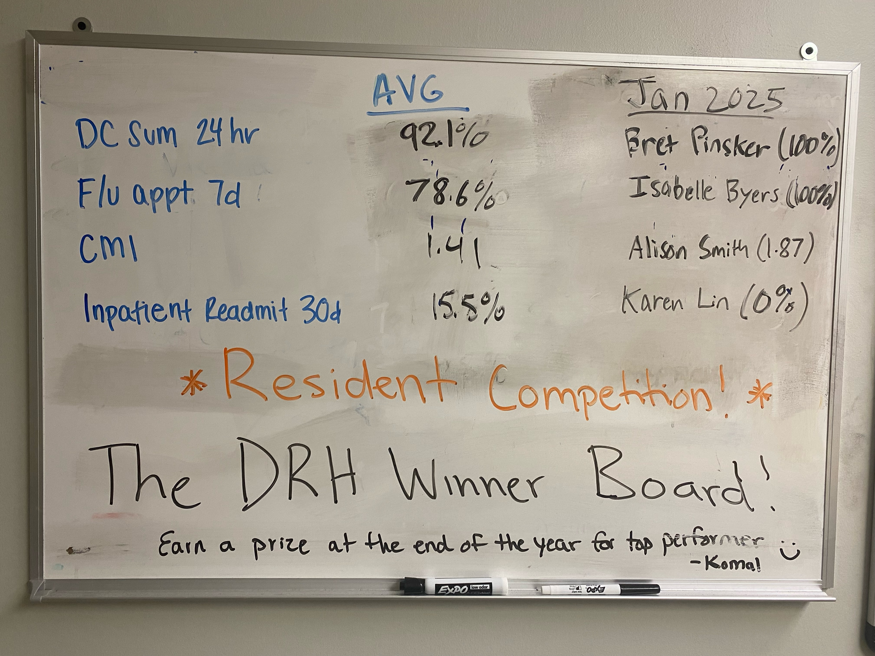
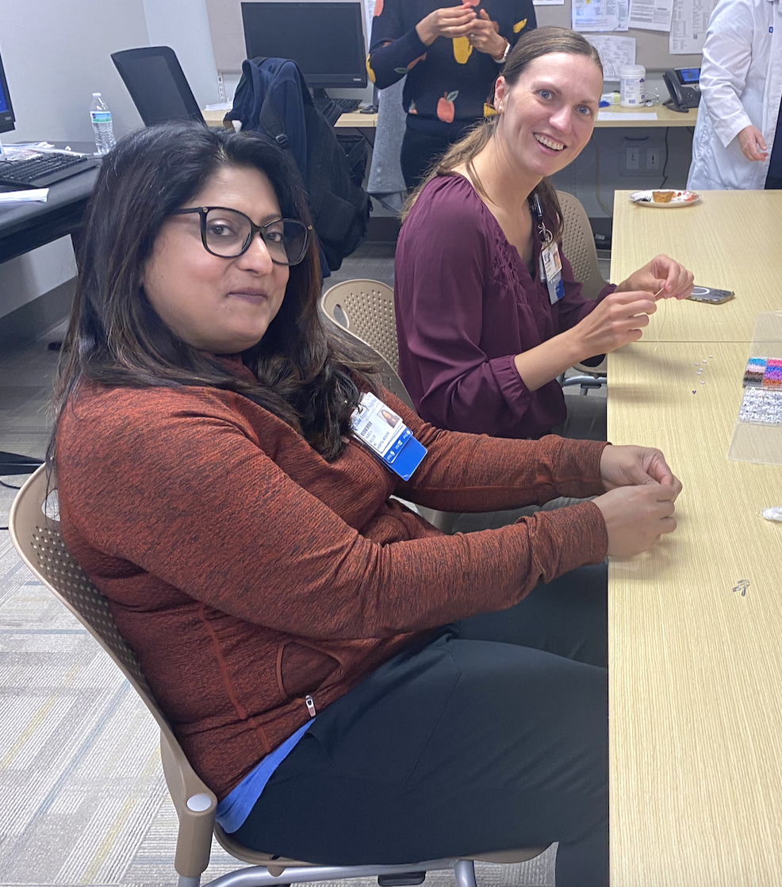
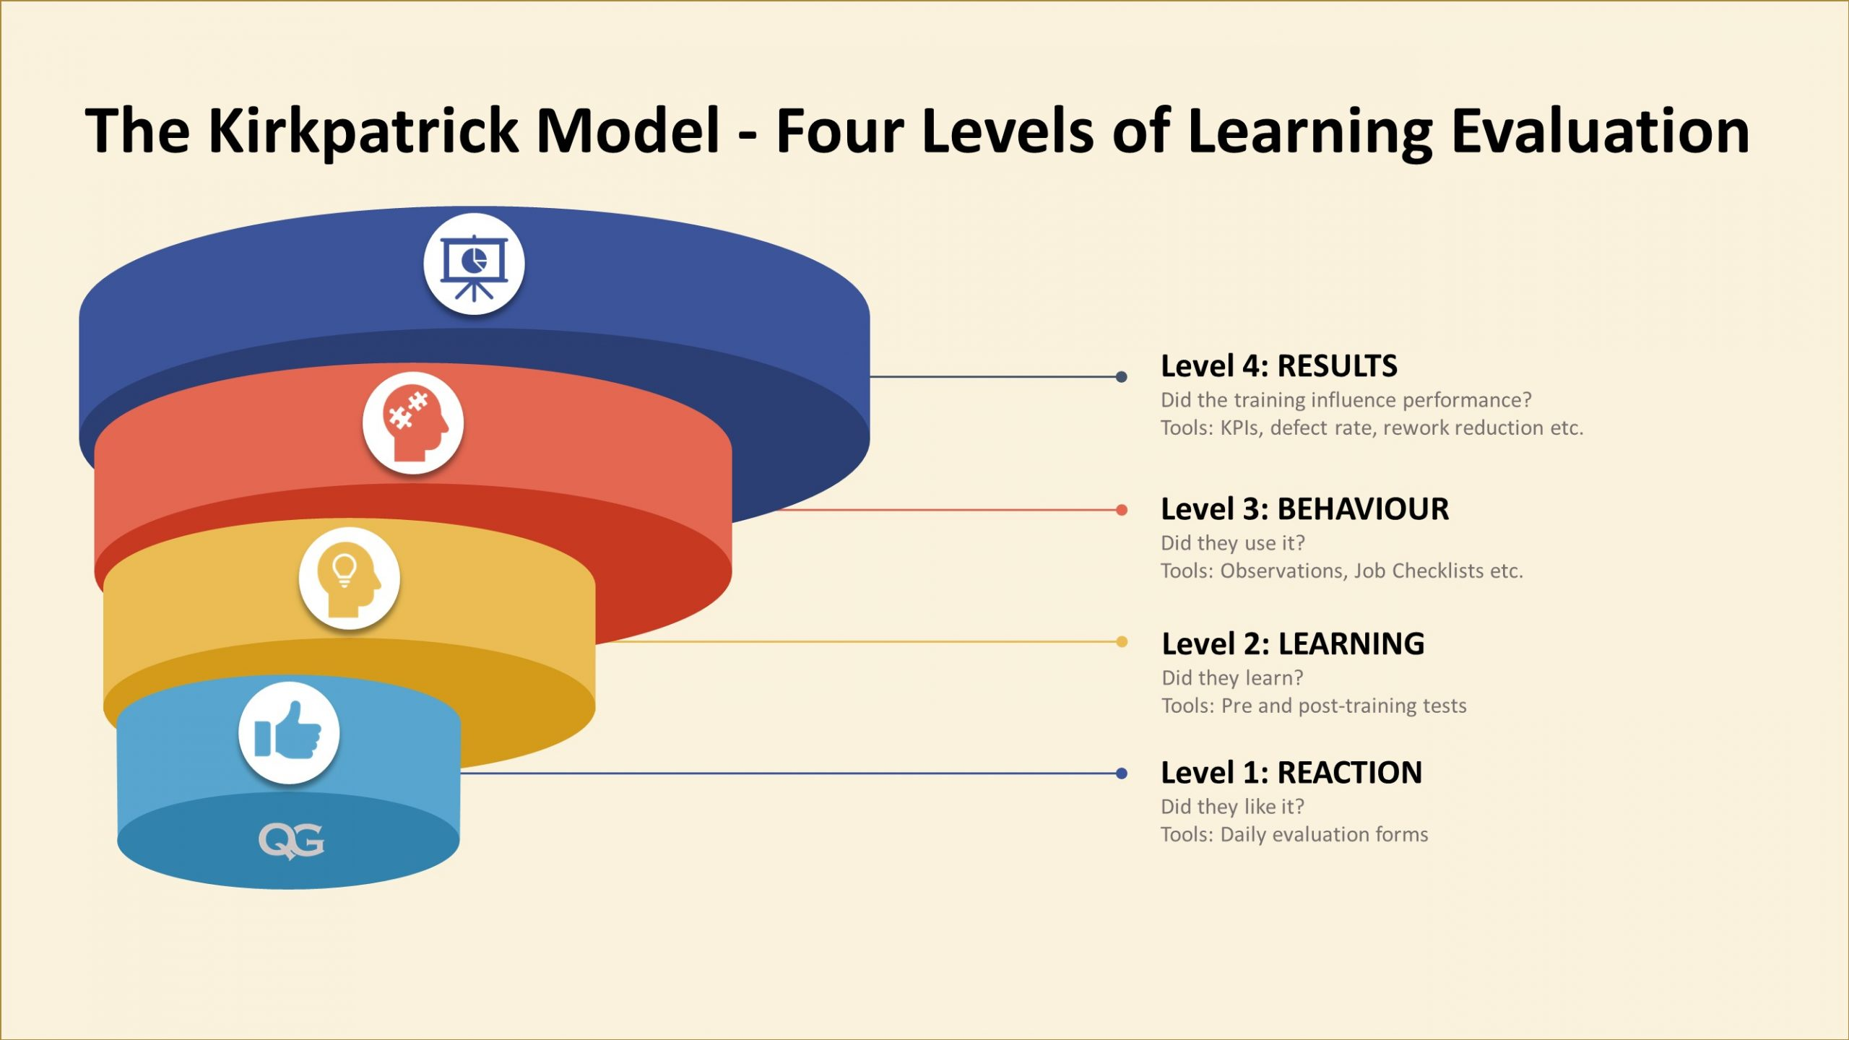
Real World Training for the Next Generation:
A curriculum for resident education focused on system-based non-clinical patient care topics
Methods
Small focus group survey
Who: Educators, residents, and CDI specialists
Pre-content survey
Who: Learners and educators
Educational content delivery
A weekly resident huddle was initiated at DRH, where internal and family medicine residents on inpatient teams convene to address operational challenges and review provider metrics.
Post content survey
Four hospitalist physicians developed a curriculum consisting of four 10-minute mini-lectures, which are presented on a rotating weekly basis by DRH internal medicine faculty.
In addition, a 45-minute teaching module was created and is delivered to second-year residents during their scheduled didactic time.
Curriculum to be evaluated based on Kirkpatrick’s evaluation model
Aim: Evaluate the current workflows, confidence, and attitudes of learners’ and educators’ towards real-world topics
Aim: Needs Assessment on interest and value of real world topics

Slide 4
Real World Training for the Next Generation:
A curriculum for resident education focused on system-based non-clinical patient care topics
ATTENDING Pre-content Survey Results
RESIDENT Pre-content Survey Results

Slide 5
Real World Training for the Next Generation:
A curriculum for resident education focused on system-based non-clinical patient care topics
RESIDENT Pre & Post-content Survey Results
Discussion
Greater than 75 % of the attending respondents thought that it is probably to definitely important to learn about CDI and >75% reported they discuss CDI with residents at least once a week during inpatient medicine rotations.
90% of the resident respondents thought it was moderately to very important to learn about health system quality metrics.
Greater than 70% of the resident respondents thought that clinical documentation is moderately to extremely important to providing high quality patient care. However, > 50 % of them felt they did not understand and were not comfortable with basic topics such as CMI and how their documentation impacts care.
Almost all resident respondents (80%) reported they were somewhat comfortable with classifying patients as inpatient vs observation, this can be improved to a level of extreme confidence with simple education.
Pre
Post
Pre
Anticipated Impact

Slide 6
Real World Training for the Next Generation:
A curriculum for resident education focused on system-based non-clinical patient care topics
Real World Training for the Next Generation:
A curriculum for resident education focused on system-based non-clinical patient care topics
Conclusion
Acknowledgements
Preliminary data shows that both attending and residents value system-based practices, but there is a gap in residents’ medical education.
A successful implementation of this new curriculum aligns the academic mission of residency training more with systems-based practice knowledge essential for navigating the complexities of modern healthcare.
Next steps: We are collecting post-curriculum data on residents’ perceived competency in certain metrics.
Rachel Hughes, MD, Assistant Professor of Medicine, DRH
Eleni Boussios, MD, Assistant Professor of Medicine, DRH
Duke CDI Team: Christine Britland, Tricia McGinn, Debbie Squatriglia
References
Centers for Medicare & Medicaid Services. (2024). Electronic clinical quality improvement overview. Retrieved from https://www.cms.gov/medicare/regulations-guidance/promoting-interoperability-programs/electronic-clinical-quality-measures-basics#:~:text=CMS%20has%20finalized%20the%20Electronic,Clinical%20Process/Effectiveness.
Accrediting Council for Graduate Medical Education. (2023). Common Program Requirements for Graduate Medical Education (Systems-Based Practice). Retrieved from https://www.acgme.org/What-We-Do/Accreditation/Common-Program-Requirements
Lurie, S. J., Mooney, C. J., & Lyness, J. M. (2009). Measurement of the general competencies of the Accreditation Council for Graduate Medical Education: A systematic review. Academic Medicine, 84(3), 301–309. https://doi.org/10.1097/ACM.0b013e3181971f08
Lin, S. P., Chang, C. W., et al. The Effectiveness of Multidisciplinary Team Huddles in Healthcare Hospital-Based Setting. J Interdisciplinary Healthcare. 2022; 15.
Massagli TL, Zumsteg JM, Osorio MB. Quality Improvement Education in Residency Training: A Review. Am J Phys Med Rehabil. 2018 Sep;97 (9):673-678. PMID: 29642078.
. Levy KL, Grzyb K, Heidemann LA, Paliani DB, Grondin C, Solomon G, Spranger E, Ellies T, Ratz D, Houchens N. Enhancing Resident Education by Embedding Improvement Specialists Into a Quality and Safety Curriculum. J Grad Med Educ. 2023 Jun;15(3):348-355. 2023 Jun 14. PMID: 37363669.
Perri G, d'Angelo M, Smaniotto C, Del Pin M, Ruscio E, Londero C, Brunelli L, Castriotta L, Brusaferro S. Do medical students and residents impact the quality of patient care? An assessment from different stakeholders in an Italian academic hospital, 2019. PLoS One. 2021 Oct 14;16(10):e0258633. PMID: 34648577
https://www.qualitygurus.com/training-effectiveness-and-evaluation-kirkpatrick-model/

