Slide 1
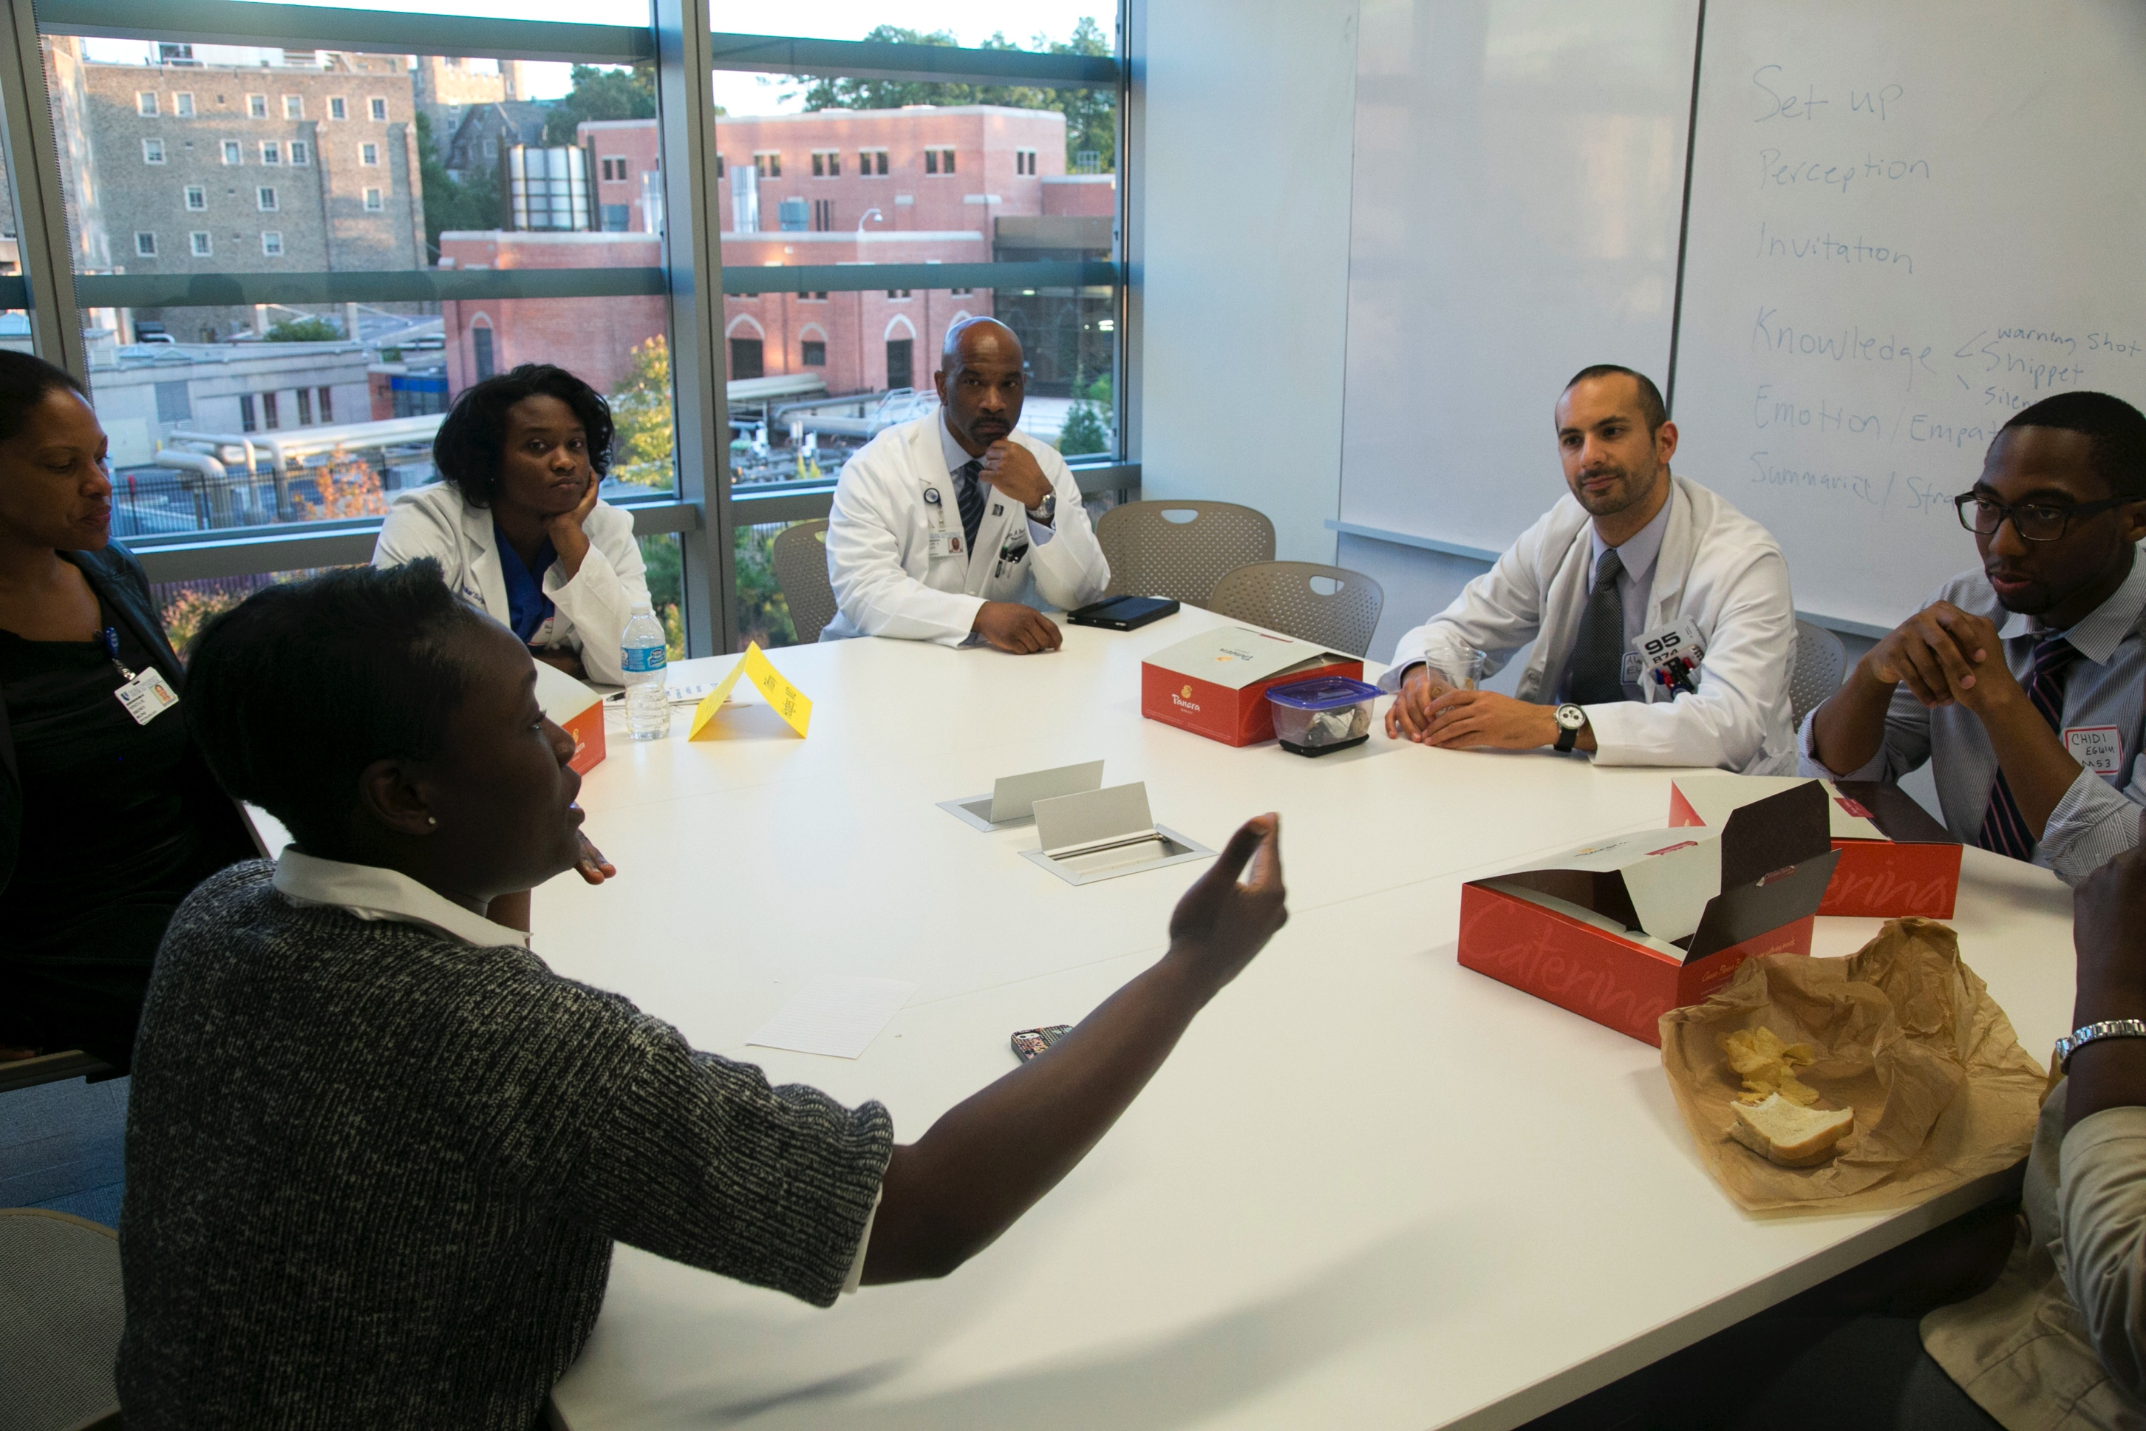
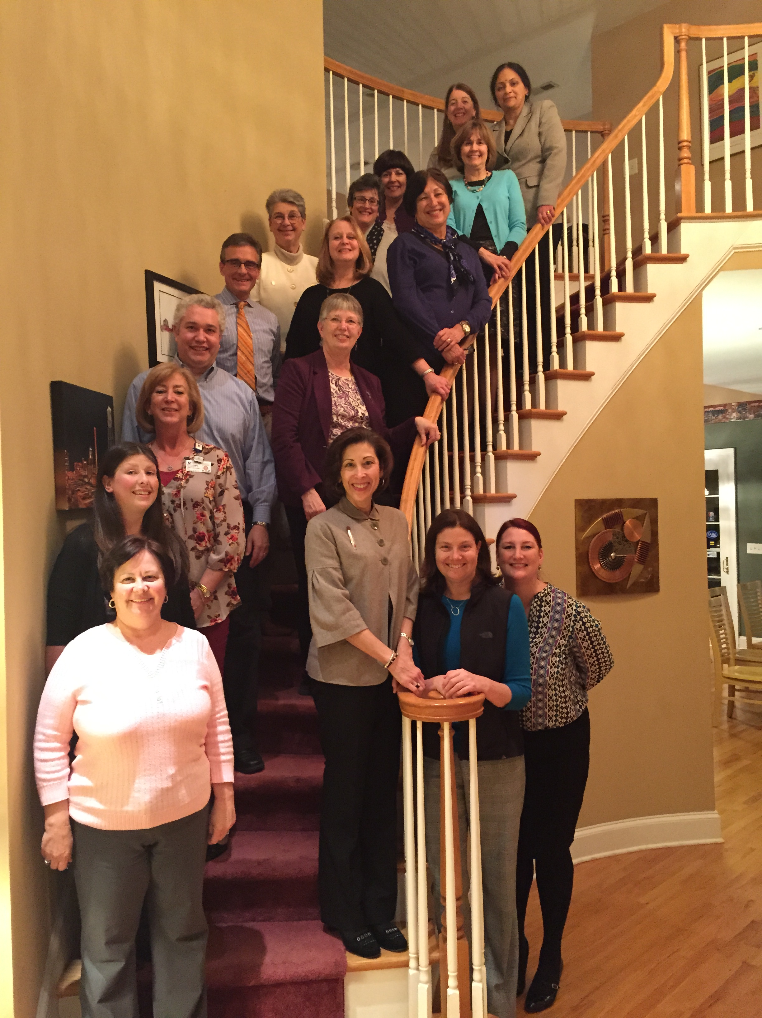
A Strategy for Creating an Interprofessional Academy at a Large Academic Center
Diana McNeill MD, Colleen O. Grochowski PhD, Alisa Nagler, JD EdD, Deborah L. Engle EdD MS, and Edward G. Buckley MD
Statement of Problem
Education is at the core of academic medical centers, yet often does not receive the resources or attention like clinical care or research
Independent activities in support of education were happening across our institution, but there was no established entity to support education
The challenge was to convince institutional leadership to organize and finance such an entity
Objectives
To create an academic home, promotion opportunities and academic credit for medical educators
To provide faculty development for HPE
To implement experiences in interprofessional education (IPE) for our students
To support and fund innovations and research in HPE
Approach
The Vice Dean for Education introduced the concept of an IPE academy and garnered broad support.
Vice Dean tasked a senior leadership team to create strategic vision and process
Academy has 3 pillars:
Recognition and Promotion
Faculty Development
Research and Innovation
Chancellor for Health Affairs approved proposal and provided funding
Outcomes
Duke Academy for Health Professions Education and Academic Development (AHEAD) launched in March 2014
Leadership by physician director (Diana McNeill) and project manager (Kristin Dickerson)
Executive and Steering committees immediately formed
Steering committee composed of folks across the institution, representing all health professions programs, specialties, levels of education and training
Duke AHEAD Mentoring, October 2014
At 1-year Anniversary
350 members
5 subcommittees formed
Communication
Educator portfolio
Faculty Development Needs Assessment
Membership
Research and Innovation
10 professional development session offerings
An Interprofessional Education Day with 56 abstract submissions
Award of 8 Duke AHEAD Innovation Grants from 52 Letters of Intent and 17 full proposal submissions
Draft and pilot-testing of 8 core educator competencies
Award of 4 Duke AHEAD Planting the Seeds of Membership (DAPSEM) grants
Draft of an educator portfolio to be used for Appointment, Promotion and Tenure
Formation of Associate membership
Promotional video describing AHEAD and its mission
Biweekly newsletter
Website and institutional education event calendar
Conclusions
As evidenced here, Duke AHEAD is already succeeding in its mission to grow a community of educators and to promote excellence in HPE
Unique in its inclusive nature (faculty, staff and trainees welcome) and interprofessional focus
Several lessons learned within first year that have contributed to quality improvement
Significance
Faculty, staff and students who had been working on individual initiatives came together to work under the Academy to help achieve their goals
Interprofessional teamwork and collaboration is the future of medicine
Duke AHEAD uniquely serves this purpose at a large academic center and can be a model for collaborations elsewhere
Duke AHEAD Educators’ Mocktail, August 2014
Duke AHEAD 1-Year Anniversary Celebration, January 2015

